Slide 1
EECS 498 System Design of a Search Engine
Winter 2026
Lecture 11: SSL
Nicole Hamilton
https://web.eecs.umich.edu/~nham/
nham@umich.edu

Slide 2
agenda
details
Google Cloud accounts
demo redux
review of reading an HTTP webpage
read an HTTPS webpage
TLS, SSL and the OpenSSL library
LinuxGetSsl

Slide 3
agenda
details
midterm
Google Cloud accounts
demo redux
review of reading an HTTP webpage
read an HTTPS webpage
TLS, SSL and the OpenSSL library
LinuxGetSsl

Slide 4
details
A few of you have missed simple assignments, like voting in the survey. Talk to me about a makeup for partial credit.

Slide 5
agenda
details
midterm
Google Cloud accounts
demo redux
review of reading an HTTP webpage
read an HTTPS webpage
TLS, SSL and the OpenSSL library
LinuxGetSsl

Slide 6
midterm
Midterm is Thursday Feb 26 during lecture period.
80 minutes, in person, on paper.
No notes or electronic devices.
W21 and W25 midterm solutions and a past review slide deck are posted in the Files > Exams > Midterm folder on Canvas.

Slide 7
agenda
details
midterm
Google Cloud accounts
demo redux
review of reading an HTTP webpage
read an HTTPS webpage
TLS, SSL and the OpenSSL library
LinuxGetSsl

Slide 8
Google Cloud accounts
Google Cloud accounts have been approved.
Link is posted on EdStem.
Make sure you can redeem your coupon.
We’re planning some labs to help you deploy to the cloud when everyone’s more ready to do that.
You only get $50 each, so don’t burn it up until the end, when you’re preparing to demo.

Slide 9
agenda
details
midterm
Google Cloud accounts
demo redux
review of reading an HTTP webpage
read an HTTPS webpage
TLS, SSL and the OpenSSL library
LinuxGetSsl

Slide 10
localhost
Last time, I had problems. I could reach my server as localhost but not using the IP address.
But some of you were able to reach it using the IP address.
What gives?
Turns out this is by design, apparently to close off a possible exploit that would allow an attacker to get inside your firewall.

Slide 11
localhost
Here’s the rule:
Use localhost to reach a server on your machine.
Use the IP address to reach a server on another machine.
I’ll now try to redo the demos.

Slide 12
agenda
details
Host: parameter
Review of reading an HTTP webpage
Read an HTTPS webpage
TLS, SSL and the OpenSSL library
LinuxGetSsl

Slide 13
HTTP over TCP/IP
Browser
Website
Imagine the connection between a browser and a website as a long pipe.
At each end is a socket you can read or write from as if it was a file.
Anything written into one end pops out and can be read at the other.

Slide 14
HTTP over TCP/IP
Browser
Website
To read a page from a website:
Look up the TCP/IP address of the website.
Create a socket.
Connect the socket to that address.
Send a GET message to request the page.
Read what comes back.

Slide 15
To get an IP address
Parse the HTTP/HTTPS path to identify the host (domain name) we’re trying to reach.
Find the IP address for that host using a Domain Name Server (DNS).

Slide 16
#include <sys/types.h>
#include <sys/socket.h>
#include <netdb.h>
int getaddrinfo(const char *node, const char *service,
const struct addrinfo *hints,
struct addrinfo **res);
void freeaddrinfo(struct addrinfo *res);
Given node and service, which identify an Internet host and a service, getaddrinfo() returns one or more addrinfo structures, each of which contains an Internet address that can be specified in a call to either:
bind(2), used by a server to specify where it will listen, or
connect(2), used by a client to connect to a server.

Slide 17
Here’s an example use.
// Get the host address, supplying hints for
// what we're looking for.
struct addrinfo *address, hints;
memset( &hints, 0, sizeof( hints ) );
hints.ai_family = AF_INET;
hints.ai_socktype = SOCK_STREAM;
hints.ai_protocol = IPPROTO_TCP;
int getaddrResult = getaddrinfo( url.Host,
*url.Port ? url.Port : "80", &hints, &address );
Later, it must be freed.
freeaddrinfo( address );

Slide 18
This is what the addrinfo structure looks like. It contains an Internet address that can be specified in a call to bind(2) or connect(2).
struct addrinfo {
int ai_flags;
int ai_family;
int ai_socktype;
int ai_protocol;
socklen_t ai_addrlen;
struct sockaddr *ai_addr;
char *ai_canonname;
struct addrinfo *ai_next;
};
The interesting part is the ai_addr, the actual IP address, which we can print.
PrintAddress( ( sockaddr_in * )address->ai_addr,
sizeof( struct sockaddr ) );

Slide 19
#include <unistd.h>
#include <sys/types.h>
#include <sys/socket.h>
int socket(int domain, int type, int protocol);
int close(int fd);
socket() creates an endpoint for communication and returns a file descriptor that can be used for reading and writing.

Slide 20
#include <unistd.h>
#include <sys/types.h>
#include <sys/socket.h>
int socket(int domain, int type, int protocol);
int close(int fd);
The domain argument specifies a communication domain. Here are the most common:
Name Purpose
AF_UNIX, AF_LOCAL Local communication
AF_INET IPv4 Internet protocols
AF_INET6 IPv6 Internet protocols

Slide 21
#include <unistd.h>
#include <sys/types.h>
#include <sys/socket.h>
int socket(int domain, int type, int protocol);
int close(int fd);
The socket has the indicated type, which specifies the communication semantics. The most common is SOCK_STREAM, a sequenced, reliable connection with two-way byte streams.
The protocol is usually IPPROTO_TCP.

Slide 22
#include <sys/types.h>
#include <sys/socket.h>
int connect(int sockfd, const struct sockaddr *addr,
socklen_t addrlen);
connect() connects the socket to the specified IP address. The addrlen argument specifies the size of addr structure.
A sockaddr * is actually a generic pointer caste from one of several possible address structures, depending on the type of a connection. For an internet connection, you’ll actually use a sockaddr_in (an internet sockaddr).

Slide 23
Here’s an example creating a socket and connecting it to an address.
// Create a TCP/IP socket.
int s = socket( AF_INET, SOCK_STREAM, IPPROTO_TCP );
assert( s != -1 );
// Connect the socket to the host address.
int connectResult = connect( s, address->ai_addr,
sizeof( struct sockaddr ) );
assert( connectResult == 0 );

Slide 24
#include <sys/types.h>
#include <sys/socket.h>
ssize_t send(int sockfd, const void *buf, size_t len, int flags);
ssize_t recv(int sockfd, void *buf, size_t len, int flags);
send() writes data into the socket. recv() reads data. Flags allow close-on-exec, noblocking reads/writes and other options.
The only difference between send() and write() or between recv() and read() is the presence of flags. With a zero flags argument, send() is equivalent to write() and recv() is equivalent to read().

Slide 25
Here’s a sample GET message we might send. Notice that the User-agent field must contain your contact info not mine. And pick a different name for your user-agent.
GET / HTTP/1.1
Host: www.nytimes.com
User-Agent: LinuxGetUrl/2.0 nham@umich.edu (Linux)
Accept: */*
Accept-Encoding: identity
Connection: close
Some sites will not even respond without a User-Agent field. It’s a free text field and can be anything as long as it exists. It’s typically the name of the software product that generated the Get + a slash followed by a version number. The OS or build environment is usually given in parens.
The Accept: and Accept-Encoding: fields are not required but typically provided.

Slide 26
Here’s an example reading from a socket and writing to stdout.
char buffer[ 10240 ];
int bytes;
while ( ( bytes = recv( s, buffer, sizeof( buffer ), 0 ) ) > 0 )
write( 1, buffer, bytes );

Slide 27
Here’s the entire main( ) for LinuxGetUrl, minus only all the code.
#include <unistd.h>
#include <sys/types.h>
#include <sys/socket.h>
#include <netdb.h>
int main( int argc, char **argv )
{
// Parse the URL
// Get the host address.
// Create a TCP/IP socket.
// Connect the socket to the host address.
// Send a GET message.
// Read from the socket until there's no more data, copying it to
// stdout.
// Close the socket and free the address info structure.
}

Slide 28
agenda
details
Host: parameter
Review of reading an HTTP webpage
Read an HTTPS webpage
TLS, SSL and the OpenSSL library
LinuxGetSsl

Slide 29
encrypted
HTTPS over TCP/IP
decrypted
Browser
Website
decrypted
encrypted
Under HTTPS, data is encrypted before being sent and decrypted when received using a public key mechanism that allows both ends to agree on a secret session key.
Done using a Secure Socket Layer (SSL) wrapper around a regular socket.

Slide 30
encrypted
HTTPS over TCP/IP
decrypted
Browser
Website
decrypted
encrypted
Under HTTPS, data is encrypted before being sent and decrypted when received using a public key mechanism that allows both ends to agree on a secret session key.
Done using a Secure Socket Layer (SSL) wrapper around a regular socket.
Here, we’ll use the OpenSSL library.

Slide 31
HTTP over TCP/IP
Browser
Website
To read a page from a website:
Look up the TCP/IP address of the website.
Create a socket.
Connect the socket to that address.
Send a GET message to request the page.
Read what comes back.

Slide 32
encrypted
HTTPS over TCP/IP
decrypted
Browser
Website
decrypted
encrypted
To read a page from a website:
Look up the TCP/IP address of the website.
Create a socket.
Connect the socket to that address.
Build an SSL layer and establish a secure connection.
Send a GET message to request the page.
Read what comes back.

Slide 33
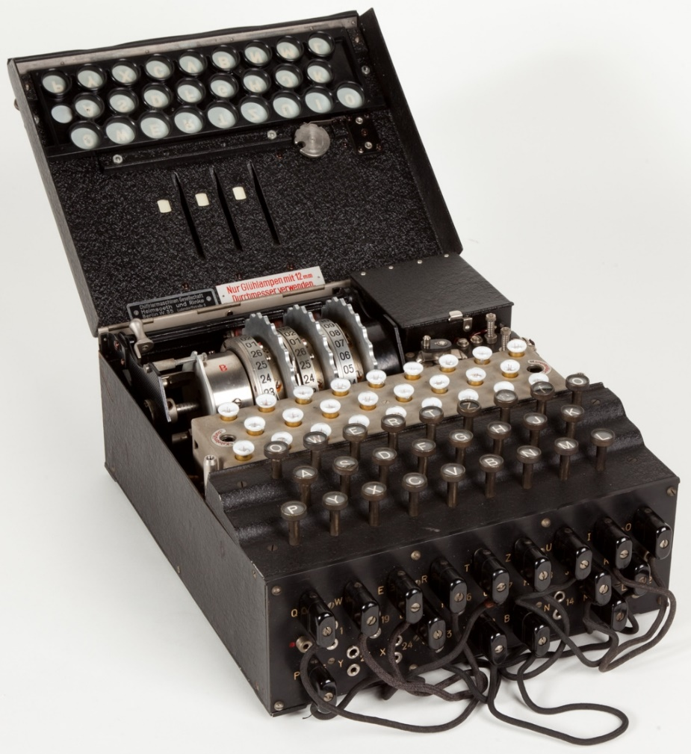
secret communications
Traditionally, two parties would have to agree on a method and key for secret communications.
A book owned by both parties might be used with messages encrypted as references to page, line and word numbers, PPPLLWW.
Mechanical methods like the German Enigma relied on secret hardware and a key.
Problems:
You need a way of communicating securely how you'll do it before you can do it.
Secrecy depends on the secrecy of both the key and the method.
Image source: https://en.wikipedia.org/wiki/Enigma_machine

Slide 34
insights
The security of the system should only depend on secrecy of the key, not the secrecy of the method.
It should be possible for anyone to see how messages are encrypted, given the key, but without the key, knowing how it's done isn't helpful in breaking the message.

Slide 35
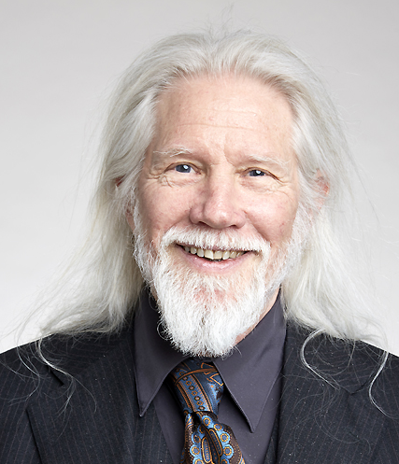
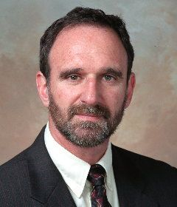
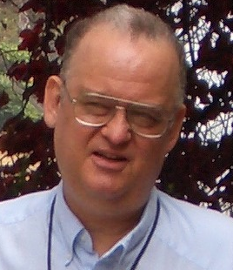
Diffie-Hellman key exchange, 1976
Whitfield Diffie
Martin Hellman
Ralph Merkle
Image sources: https://en.wikipedia.org/wiki/Whitfield_Diffie
https://en.wikipedia.org/wiki/Martin_Hellman
https://en.wikipedia.org/wiki/Ralph_Merkle

Slide 36
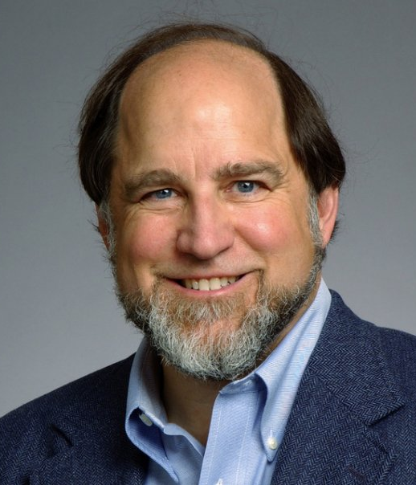
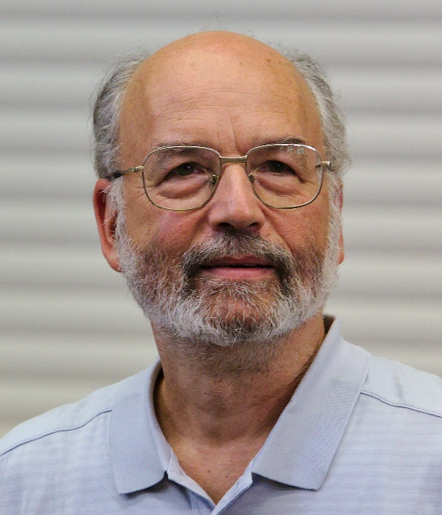
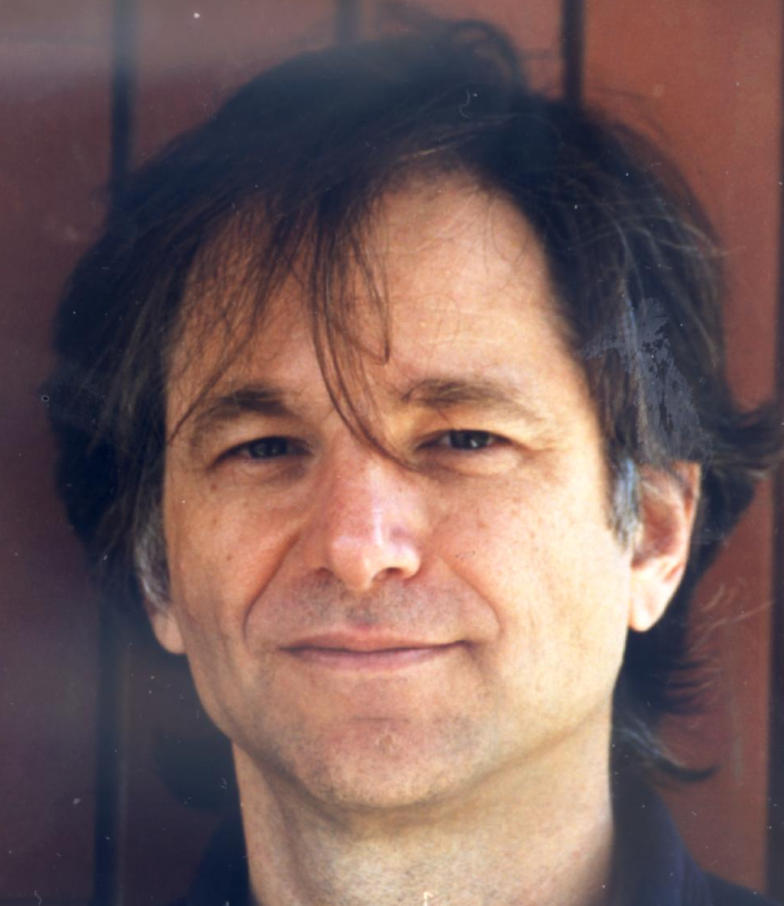
RSA public key encryption, 1978
Ron Rivest
Adi Shamir
Leonard Adleman
Image sources: https://en.wikipedia.org/wiki/Ron_Rivest
https://en.wikipedia.org/wiki/Adi_Shamir
https://en.wikipedia.org/wiki/Leonard_Adleman

Slide 37
public key encryption
Uses pairs of private and public keys that are related by a mathematical formula that’s hard to reverse, e.g., factoring of very large numbers.
To get started:
I create (or pick) a private key which I keep secret,
I use that to create a public key, which I can share with the world.
If I want to send you an encrypted message:
I encrypt using my private key and your public key.
You decrypt using my public key and your private key.
Does not require a secure channel for initial exchange of secret keys.

Slide 38
encryption methods
Symmetric
Uses one key
Key must already be shared
Much faster
Short 128 to 256 bit keys
Asymmetric
Uses two keys, public and private
Does not require previous sharing
Slow
Very long 2048+ bit keys

Slide 39
SSL / TLS Handshake
Sends a message to server with a list of cipher suites and SSL/TLS versions it supports.
Chooses a cipher suite and TLS version and sends its certificate and public key.
Verifies certificate, extracts public key, uses it to encrypt a new pre-master key, which it sends to the server.
Client
Server
Uses its private key to decrypt the pre-master key.
Both use the pre-master key to compute a shared secret key.
Sends encrypted message announcing it's switching to encryption with the shared secret.
Decrypts and verifies message, sends message encrypted with the shared secret.
Both use encryption using the shared secret for the rest of the session.

Slide 40
public key encryption
RSA and Elliptic Curve Diffie-Hellman (ECDH/ECDHE) are the most commonly used PKE algorithms.
Modern TLS (1.3) heavily favors ephemeral key exchanges like ECDHE to provide forward secrecy.
An ephemeral key is a unique, temporary session key.
Forward secrecy (FS) is a security feature ensuring that a compromise of long-term server private keys does not compromise past session keys.
Using ephemeral key exchanges ensures that even if an attacker records encrypted traffic and later steals the server's private key, they cannot decrypt previously recorded messages.

Slide 41
once the handshake is complete
Once the TLS handshake establishes a shared secret, the subsequent data communication is encrypted using faster symmetric encryption.
AES-GCM (Advanced Encryption Standard with Galois/Counter Mode) is the most common modern standard.
Other commonly used algorithms include ChaCha20-Poly1305 and, in older configurations (TLS 1.2), AES-CBC.

Slide 42
agenda
details
Host: parameter
Review of reading an HTTP webpage
Read an HTTPS webpage
TLS, SSL and the OpenSSL library
LinuxGetSsl

Slide 43
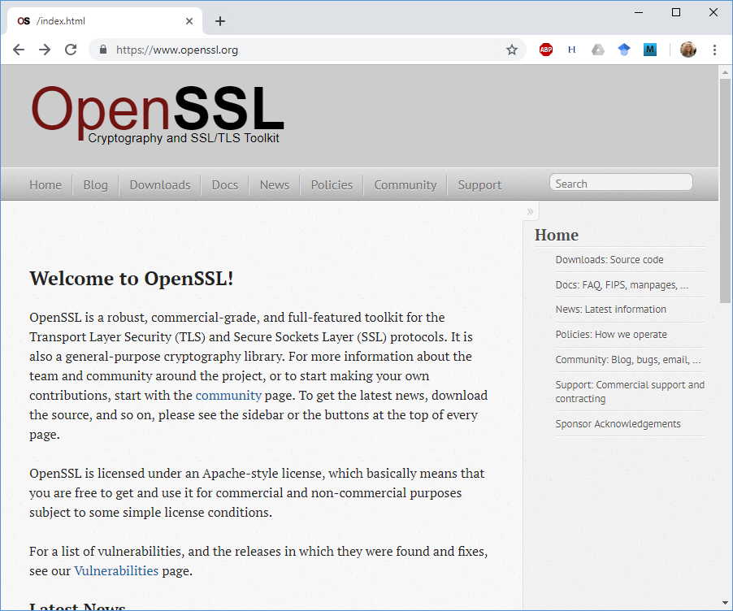
OpenSSL
The SSL/TLS handshake it too complex and rigorous to write on our own.
OpenSSL is a library you get to use.
It works on both Windows and Linux.

Slide 44
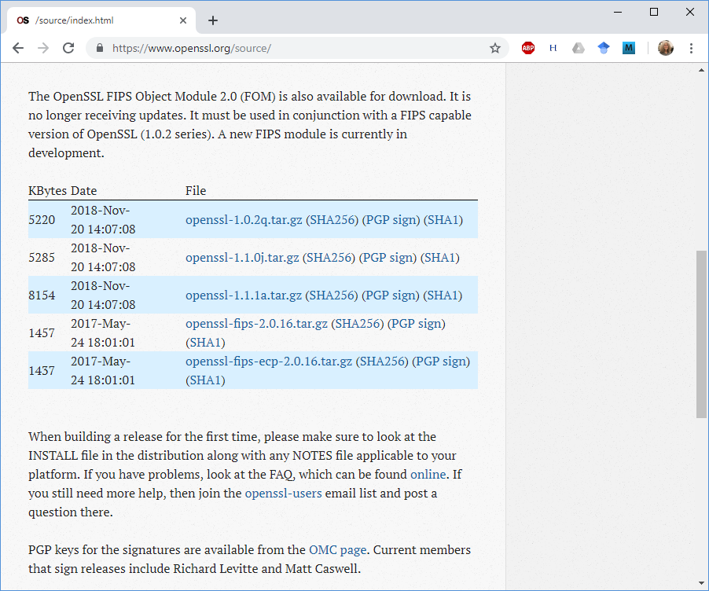
OpenSSL
But the downloads from OpenSSL are source only.
You have to build and install it yourself.
And it will not build in directory path with spaces, e.g., your Google drive path.
Alternative is to use apt-get install.

Slide 45
apt-get install OpenSSL
1. Install the OpenSSL library.
sudo apt-get install libssl-dev
#include <openssl/ssl.h>
g++ LinuxGetSsl.cpp -lssl –lcrypto
-o LinuxGetSsl
2. Include the openssl header.
3. Compile and link the SSL and crypto libraries.

Slide 46
#include <openssl/ssl.h>
int SSL_library_init(void);
SSL_library_init() initializes the SSL library.

Slide 47
#include <openssl/ssl.h>
int SSL_library_init(void);
SSL_CTX *SSL_CTX_new(const SSL_METHOD *method);
SSL *SSL_new(SSL_CTX *ctx);
SSL_library_init() initializes the SSL library.
SSL_CTX_new() creates a new SSL_CTX context object as framework to establish TLS/SSL enabled connections.
SSL_new() creates a new SSL structure need to hold the data for a TLS/SSL connection.

Slide 48
Here’s an example initializing the SSL layer.
// Build the SSL layer.
SSL_library_init( );
SSL_CTX *ctx = SSL_CTX_new( SSLv23_method( ) );
assert( ctx );
SSL *ssl = SSL_new( ctx );
assert( ssl );

Slide 49
#include <openssl/ssl.h>
int SSL_set_fd(SSL *ssl, int fd);
SSL_set_fd() sets the file descriptor fd as the input/output facility for the TLS/SSL (encrypted) side of ssl.
fd will typically be the socket file descriptor of a network connection.

Slide 50
#include <openssl/ssl.h>
int SSL_connect(SSL *ssl);
SSL_connect() initiates the TLS/SSL handshake with a server.

Slide 51
Here’s an example initializing the SSL layer.
// Fill in the socket we'll be using.
SSL_set_fd( ssl, s );
// Fill in the host we're trying to connect to.
SSL_set_tlsext_host_name( ssl, url.Host );
// Establish an SSL connection.
int sslConnectResult = SSL_connect( ssl );
assert( sslConnectResult == 1 );
The requirement to fill in the host is new.
Apache servers got an update in 2025 that now requires that you fill in the host name in the SSL.

Slide 52
#include <openssl/ssl.h>
int SSL_write(SSL *ssl, const void *buf, int num);
int SSL_read(SSL *ssl, void *buf, int num);
SSL_write() writes num bytes from the buffer buf into the specified ssl connection.
SSL_read() tries to read num bytes from the specified ssl into the buffer buf.

Slide 53
Here’s an example reading and writing.
while ( ( bytes = SSL_read( ssl, buffer,
sizeof( buffer ) ) ) > 0 )
write( 1, buffer, bytes );

Slide 54
Shutdown and free up resources at the end.
SSL_shutdown( ssl );
SSL_free( ssl );
SSL_CTX_free( ctx );

Slide 55
agenda
details
Host: parameter
Review of reading an HTTP webpage
Read an HTTPS webpage
TLS, SSL and the OpenSSL library
LinuxGetSsl

Slide 56
Agenda
Course details.
Correction on the Host: parameter.
Review of reading an HTTP webpage.
Read an HTTPS webpage.
TLS, SSL and the OpenSSL library.
LinuxGetSSL.

Slide 57
Here’s the entire main( ) for LinuxGetSsl, minus only all the code.
#include <unistd.h>
#include <sys/types.h>
#include <sys/socket.h>
#include <openssl/ssl.h>
#include <netdb.h>
int main( int argc, char **argv )
{
// Parse the URL
// Get the host address.
// Create a TCP/IP socket.
// Connect the socket to the host address.
// Build an SSL layer and set it to read/write
// to the socket we've connected.
// Send a GET message.
// Read from the SSL socket until there's no more data, copying it to
// stdout.
// Close the socket and free the address info structure.
}

